Slide 1
Rideshare App
Divyesh, Sai Chittela, Andrew, Akshay and Maanas
Notes:
Consider adding wireframes to the next presentation

Slide 2
About the software
Exclusively for Virginia Tech
This app is only for VT students to request rides from their VT peers.
Community Inclusion
The app’s purpose is to connect students in this community to be able to help one another in a safe and efficient manner.
Point Currency System
Currency in the app will be in points, which can be earned by giving rides or these points may be purchased with real money (for users who do not have access to a vehicle).
The goal of this app is eliminate the use of payment for rides as consistent drivers will never need to pay for rides but instead utilize accumulated points

Slide 3
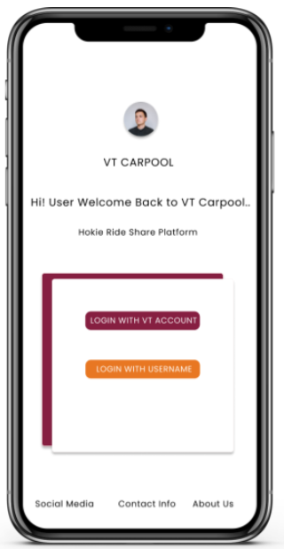
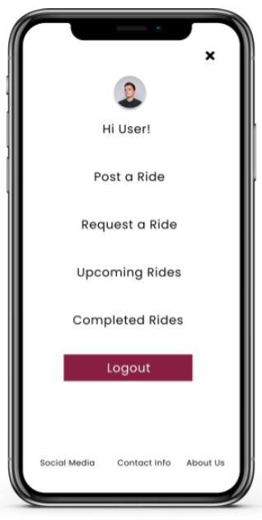
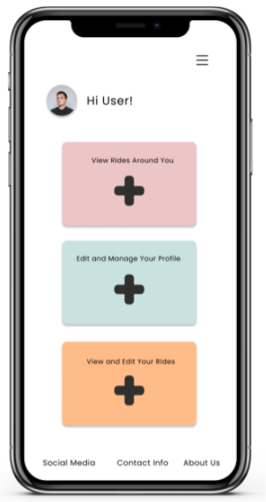
User-Interface
Login Screen
Welcome Page
Trip Management

Slide 4
Features
Drivers
Riders
Accept/decline ride requests
View rider info such as rating & destination
Cash out method
Earn points towards free rides with each successful trip
Expenses center
Gas, car cleanup, other issues
Request a ride + cost estimate
Cancel request as needed
Schedule future rides
Split fare with friends or other passengers
Leave rating for driver
Leave tip for driver
Payment processing method

Slide 5
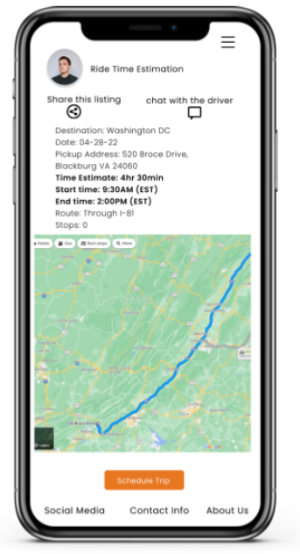
Features
Verify all users are VT students
Riders & drivers
Support Center
Payment issues, app usage issues, bug reporting
Trip issue center
Car issues (e.g. breakdowns)
Other issues (rider needs to cancel)
Safety center
Protection for both riders and drivers

Slide 6
Challenges
Solutions
Eliminating monetary transactions
Prioritizing point currency system over monetary funds such as the USD.
Generating trip cost estimates
Calculating trip cost without trip history and app data.
Offering discounted ride prices when a point payment currency is used as opposed to monetary funds.
Extrapolating estimates from traditional map services and applying points per mile algorithm.

Slide 7
Lessons Learned
Organizing and brainstorming functional requirements
Team building skills
Developing practical functional requirements
Data modeling and performing requirement analysis
Use Case Diagrams and Class Diagrams
Entity Relationship Diagrams
Design and wireframes
Prototype design techniques to develop UI
Using front-end design tools
Integrating point system of payment
Managing multiple methods of payment

Slide 8
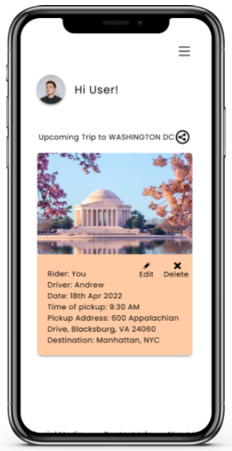
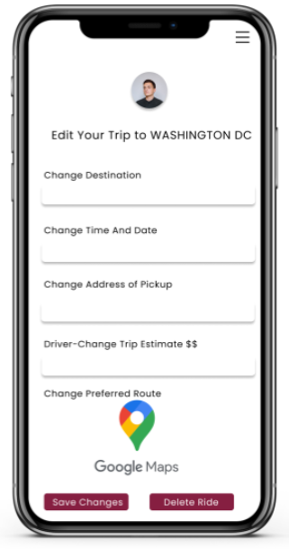
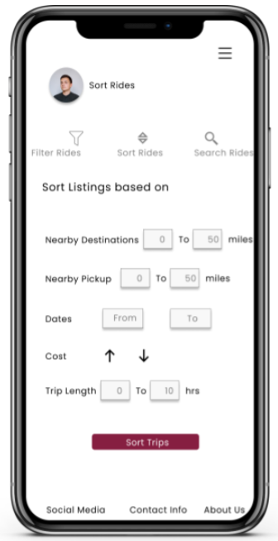
Summary
Virginia Tech Students
Point Currency System
Community Inclusion

Slide 9
GitHub Repository
https://github.com/dpendurthi/CS-3704

Slide 10
Questions?
Notes:
Scalability to other universities?
Differences between other existing rideshare platforms

